Slide 1
Tutorial on how to replicate results from CSREP tutorial
Ha Vu
Ernst lab at UCLA
Summer 2022

Slide 2
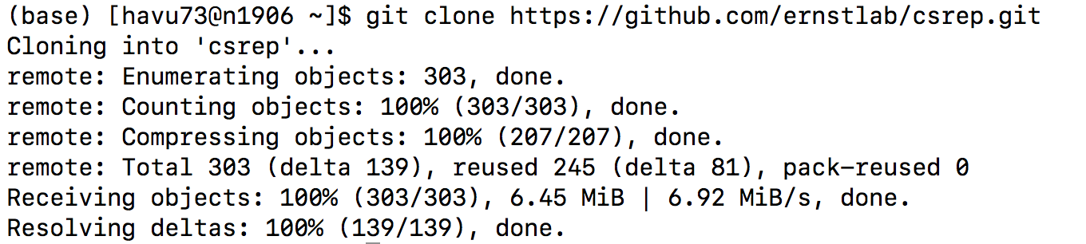
Clone the repository
Then cd into the csrep folder

Slide 3
Install all dependencies
We recommend using conda to install snakemake first. This command worked for us to install snakemake into an environment named csrep:
conda create -c conda-forge -c bioconda -n csrep snakemake
Then, activate the csrep environment: conda activate csrep
Then, you can install other dependencies using conda and the file ./env/csrep_env.yml

Slide 4
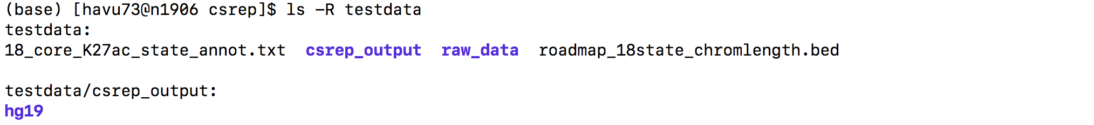
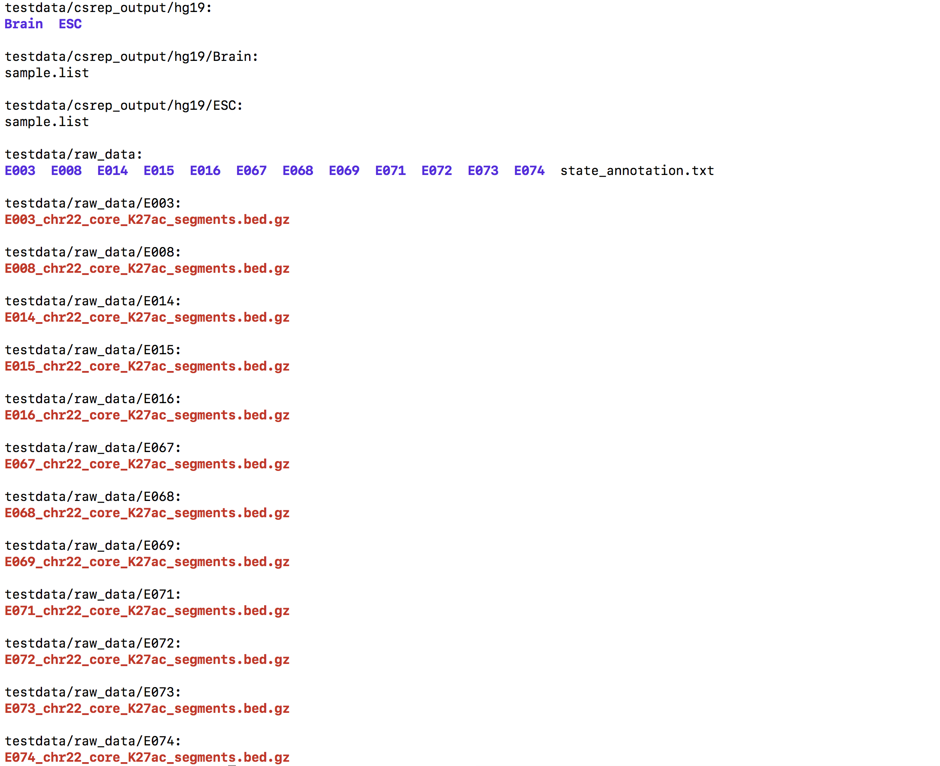
Provided test data for the tutorial: inside folder testdata

Slide 5
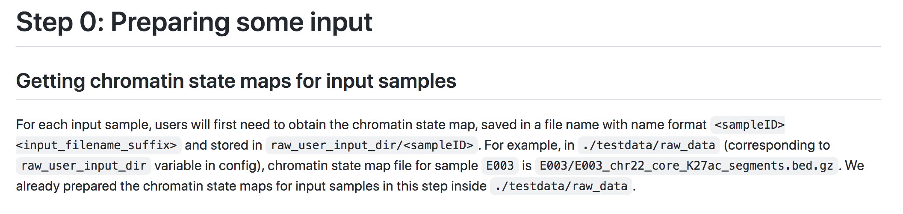
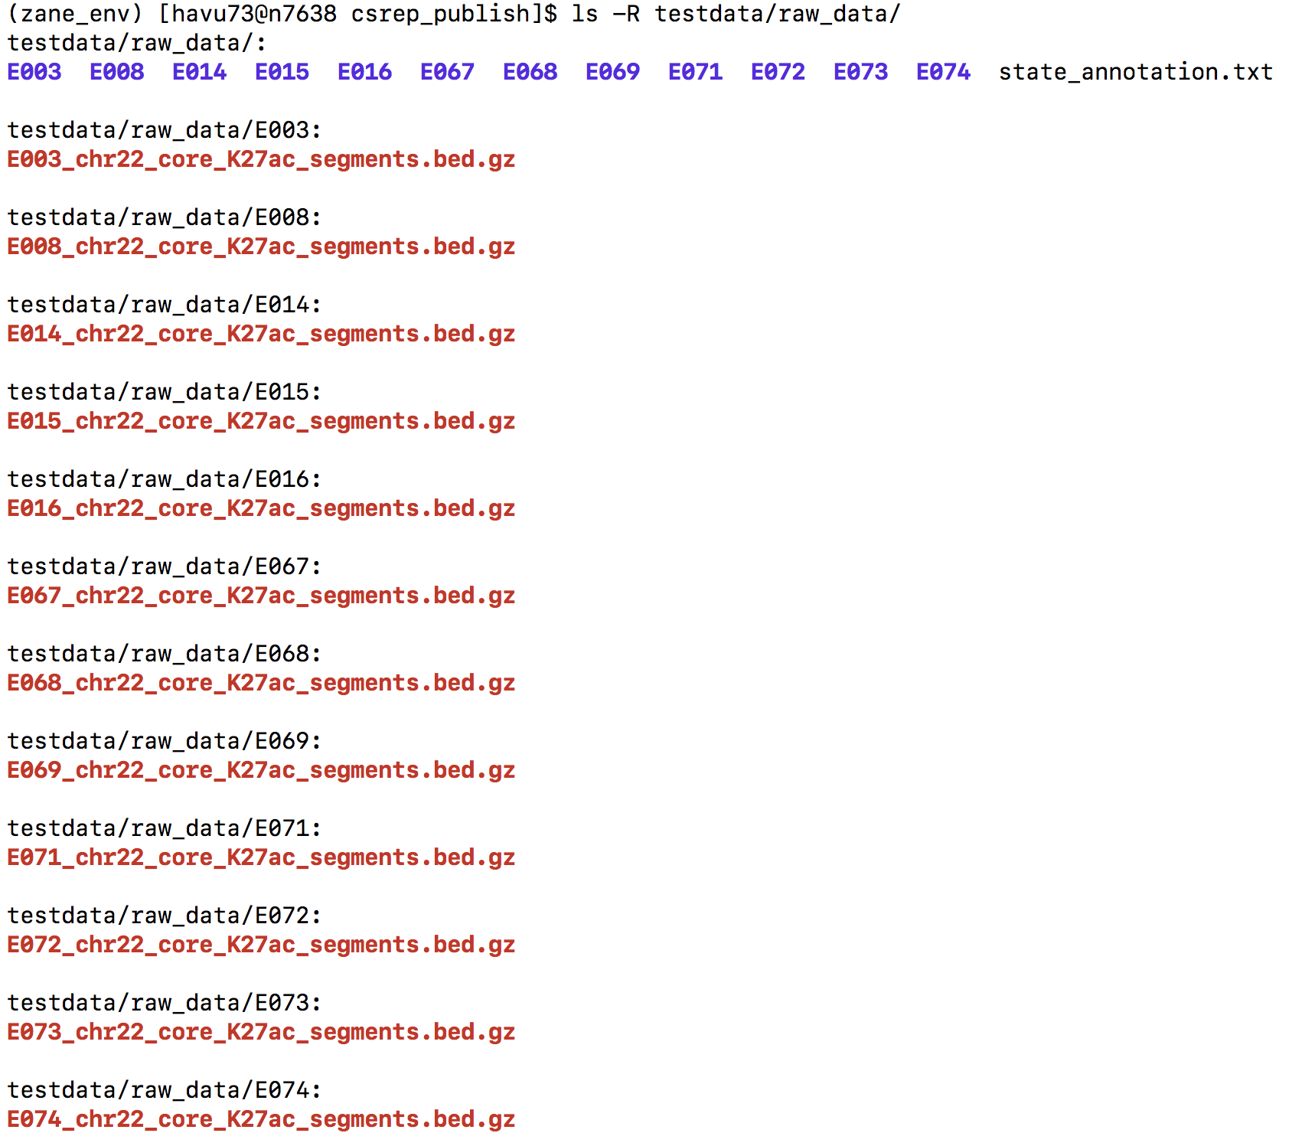
Following the tutorial, step 0.0
Chromatin state maps for input samples have already been provided for you in folder ./testdata/raw_data.

Slide 6
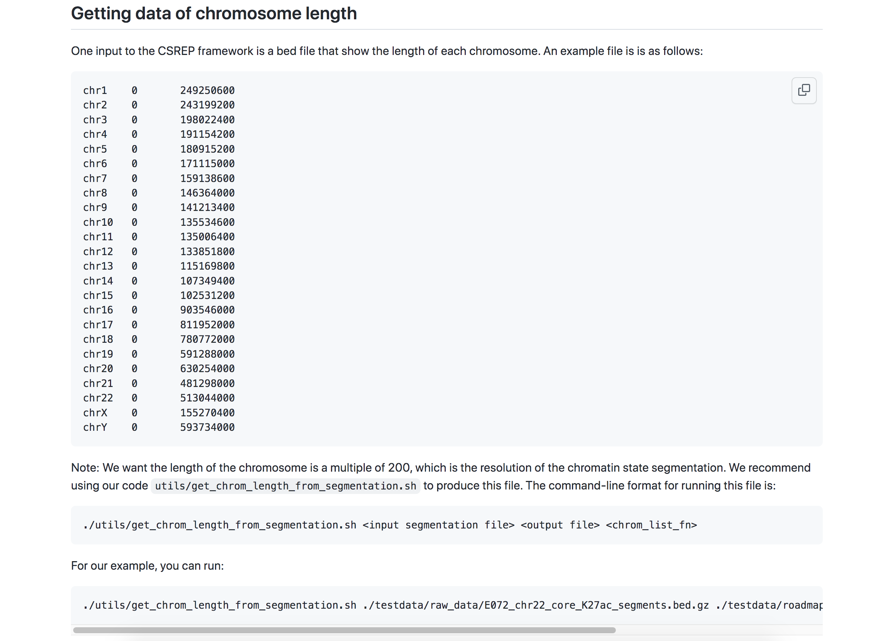
Following the tutorial, step 0.1

Slide 7
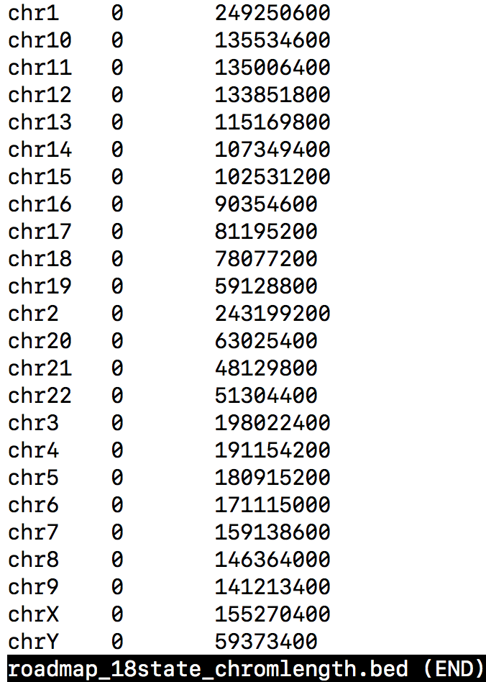
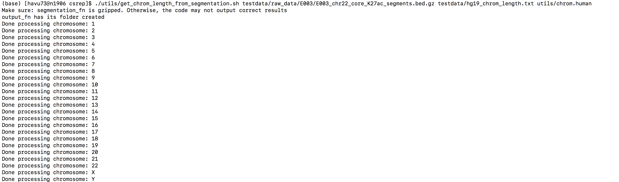
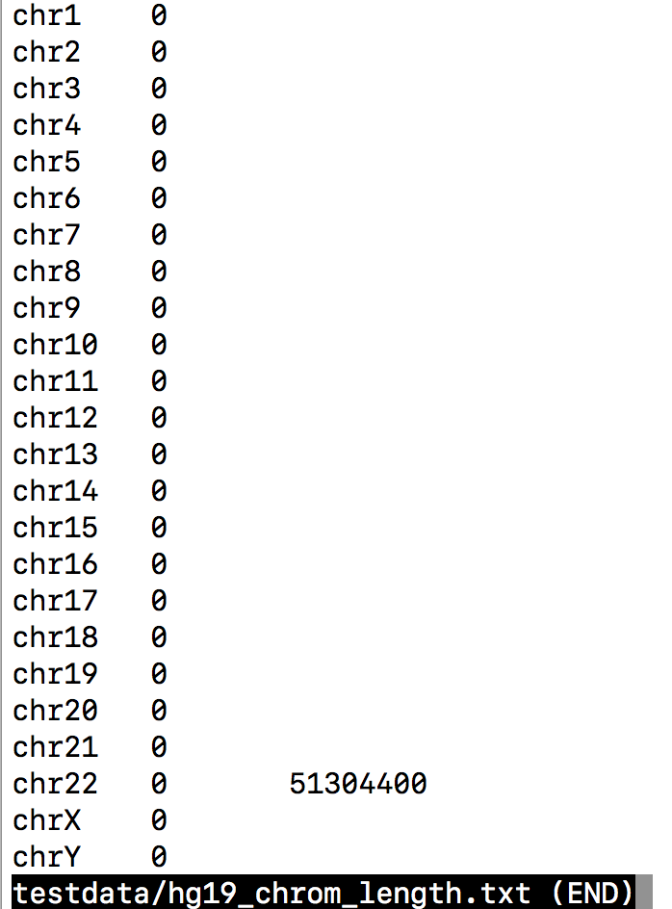
Get the chromosome length from segmentation data
Provided file that specifies chromosome length
You can also use our code provided in utils to get chromosome length from raw segmentation data. Example command:
Resulting output file only shows the length for chromosome 22, because our input segmentation file only contains data for chr22. CSREP will still run smoothly with this file

Slide 8
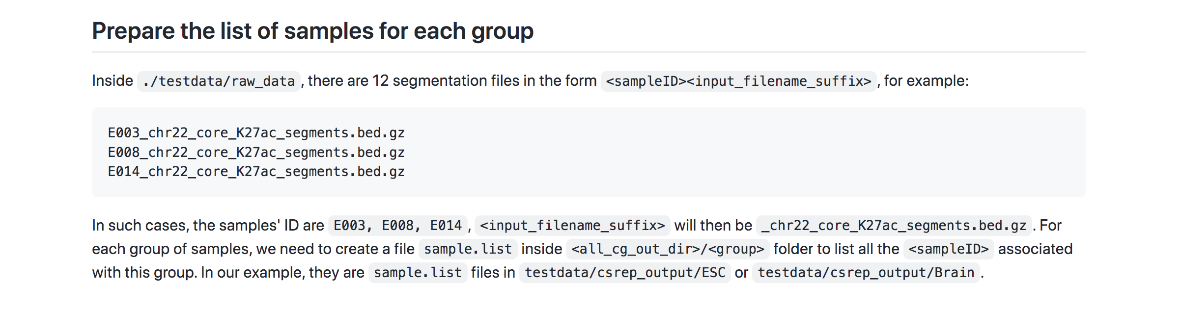
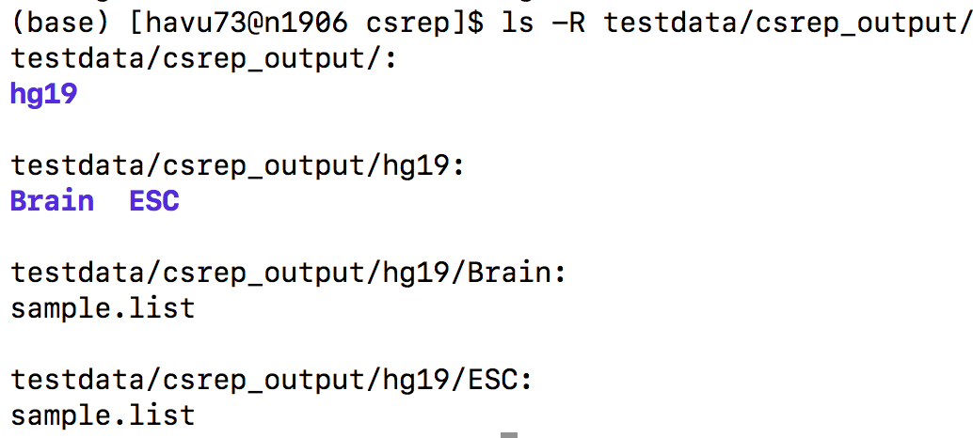
Following the tutorial, step 0.2
We already provided the sample.list files inside the output folder for ESC and Brain for our tutorial. Therefore, you won’t have to do any thing for this step in order to follow the tutorial.
But, if you want to apply CSREP for new data, you will need to create folders: <all_cg_out_dir>/<group> for each group of samples you are interested in. Then, you will need to place the files sample.list to the corresponding group’s output folder.

Slide 9
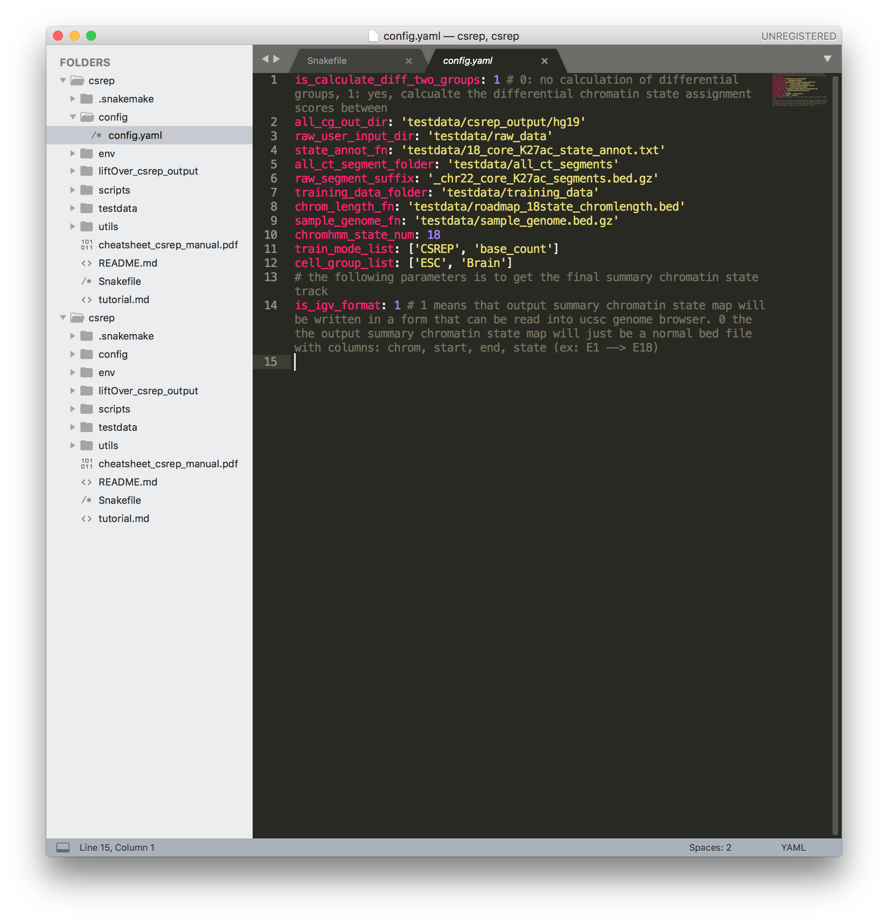
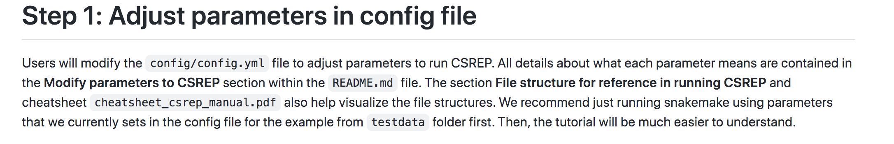
Following the tutorial, step 1
Right now, all the parameters have been set as how they should be to follow the tutorial. Therefore, you don’t have to do anything for this step to replicate the tutorial. Note: the parameters are set such that we will produce results based on both CSREP and base_count methods.
If you want to apply CSREP for your own data in the future, make sure you understand what each parameter means and how to modify it for your own purposes. Please refer to the readme, the tutorial, the cheatsheet to help you understand the meaning of each variable in this config file.

Slide 10
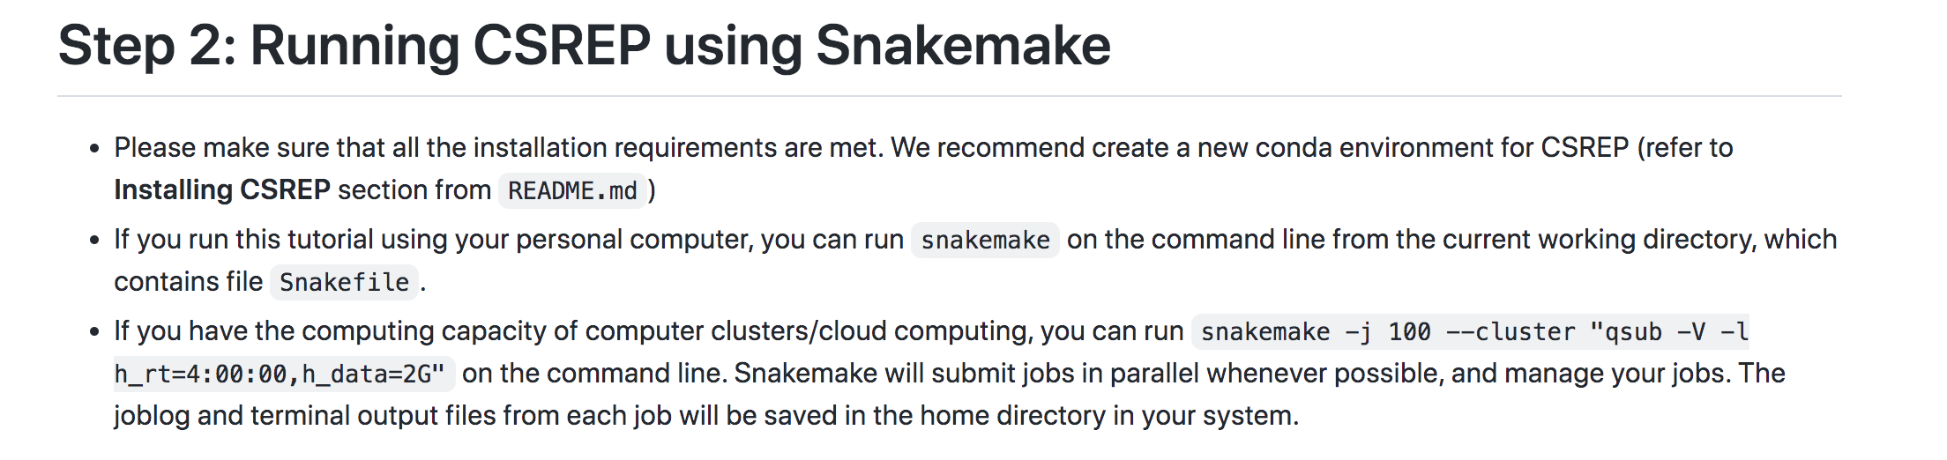
Following the tutorial, step 2

Slide 11
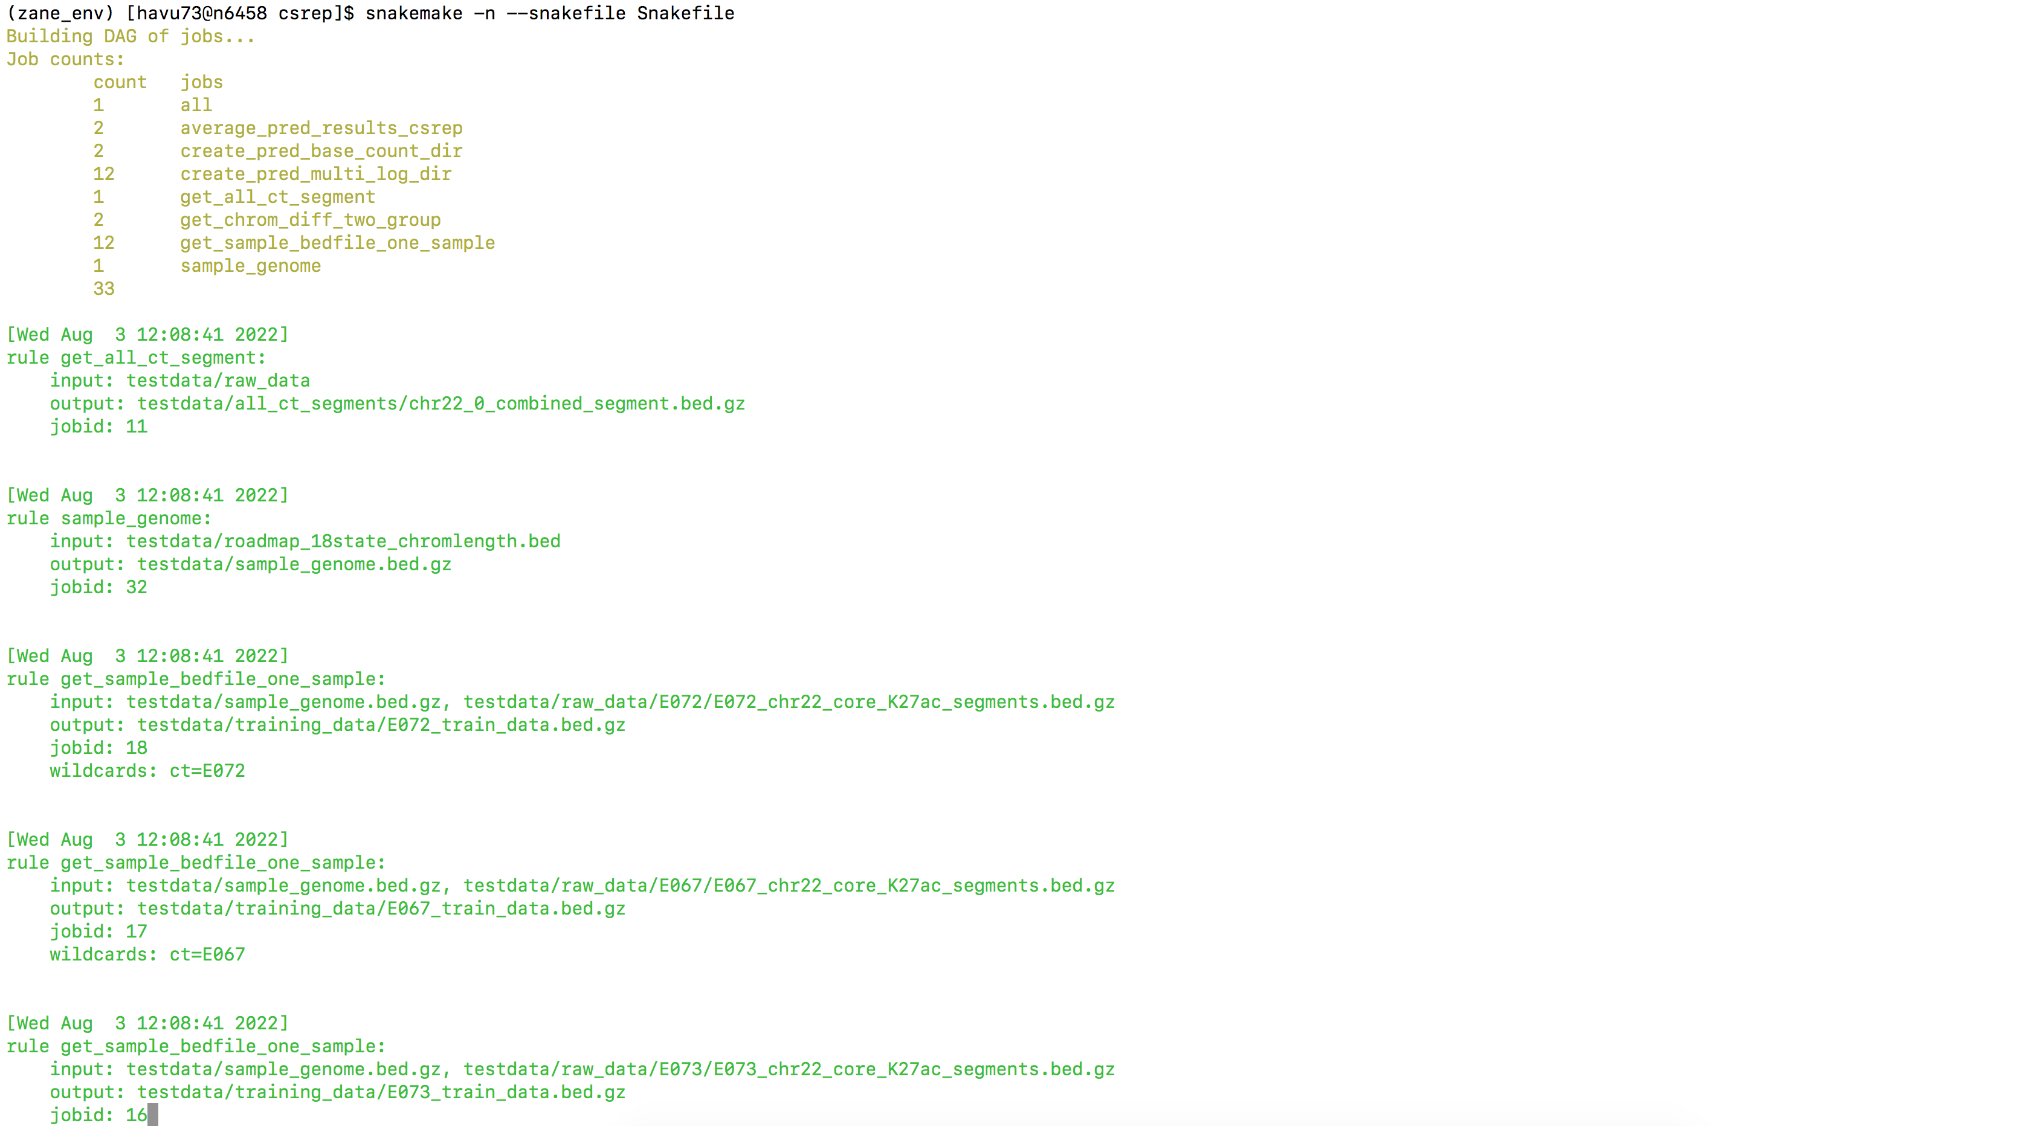
Following the tutorial, step 2
First, get a dry run of snakemake with –n flag. Below is a screenshot of output

Slide 12
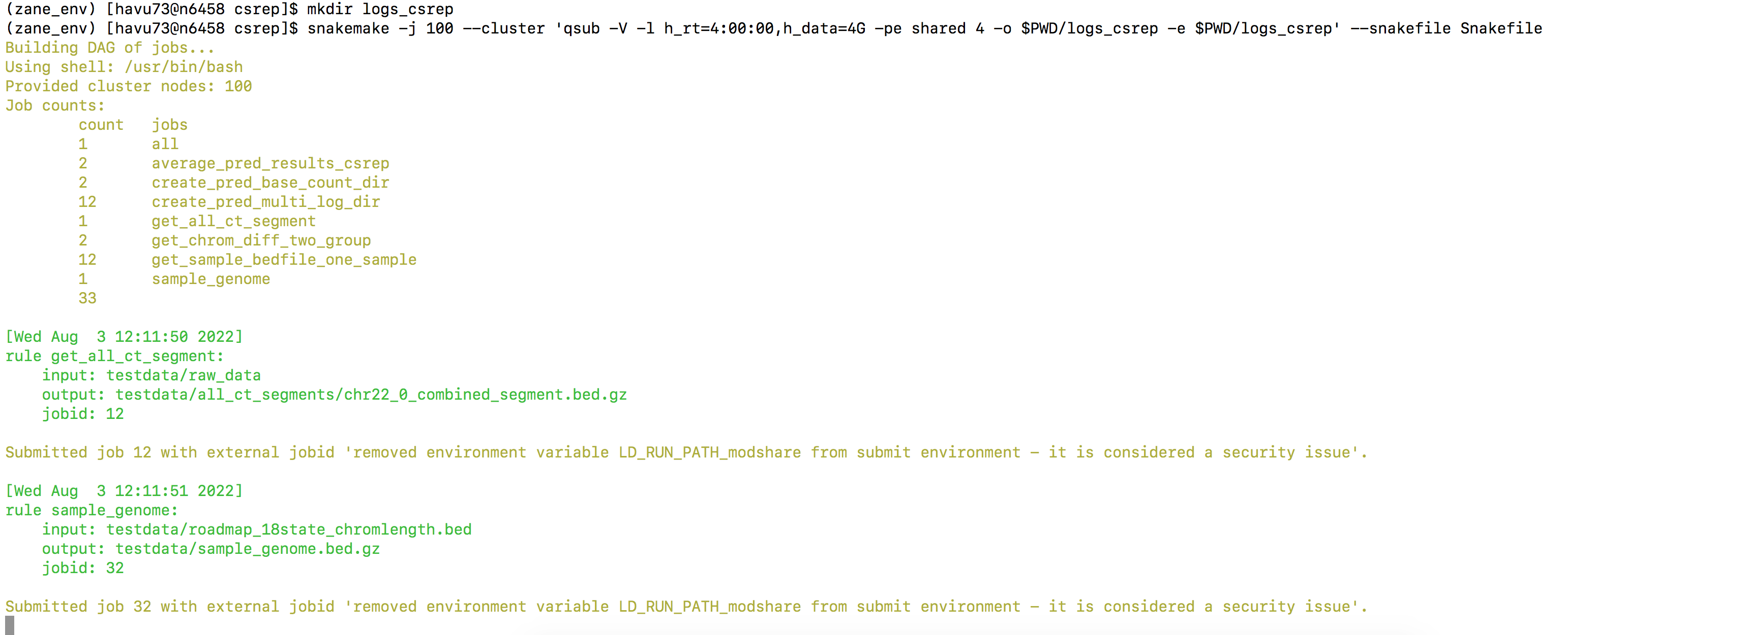
Following the tutorial, step 2
Now, we shall call on snakemake command to run CSREP.
-j 100: submit at most 100 jobs in parallel at a time
--cluster ‘<your qsub command to submit the job>’
qsub : -V flag allows us to keep the local environment to run each job
qsub: -l h_rt, h_data flags specifies run time and data for each job
qsub: -pe shared 4: run each job with 4 cores.
qsub: -o and –e flags can be used to specify the folder where all the output and error log files of snakemake are store.
Then, we just let snakemake run and do all the job-sitting. We recommend using tmux when you run snakemake, to better manage your screens. The total runtime on test data, given our computing cluster settings, is ~20 minutes.

Slide 13
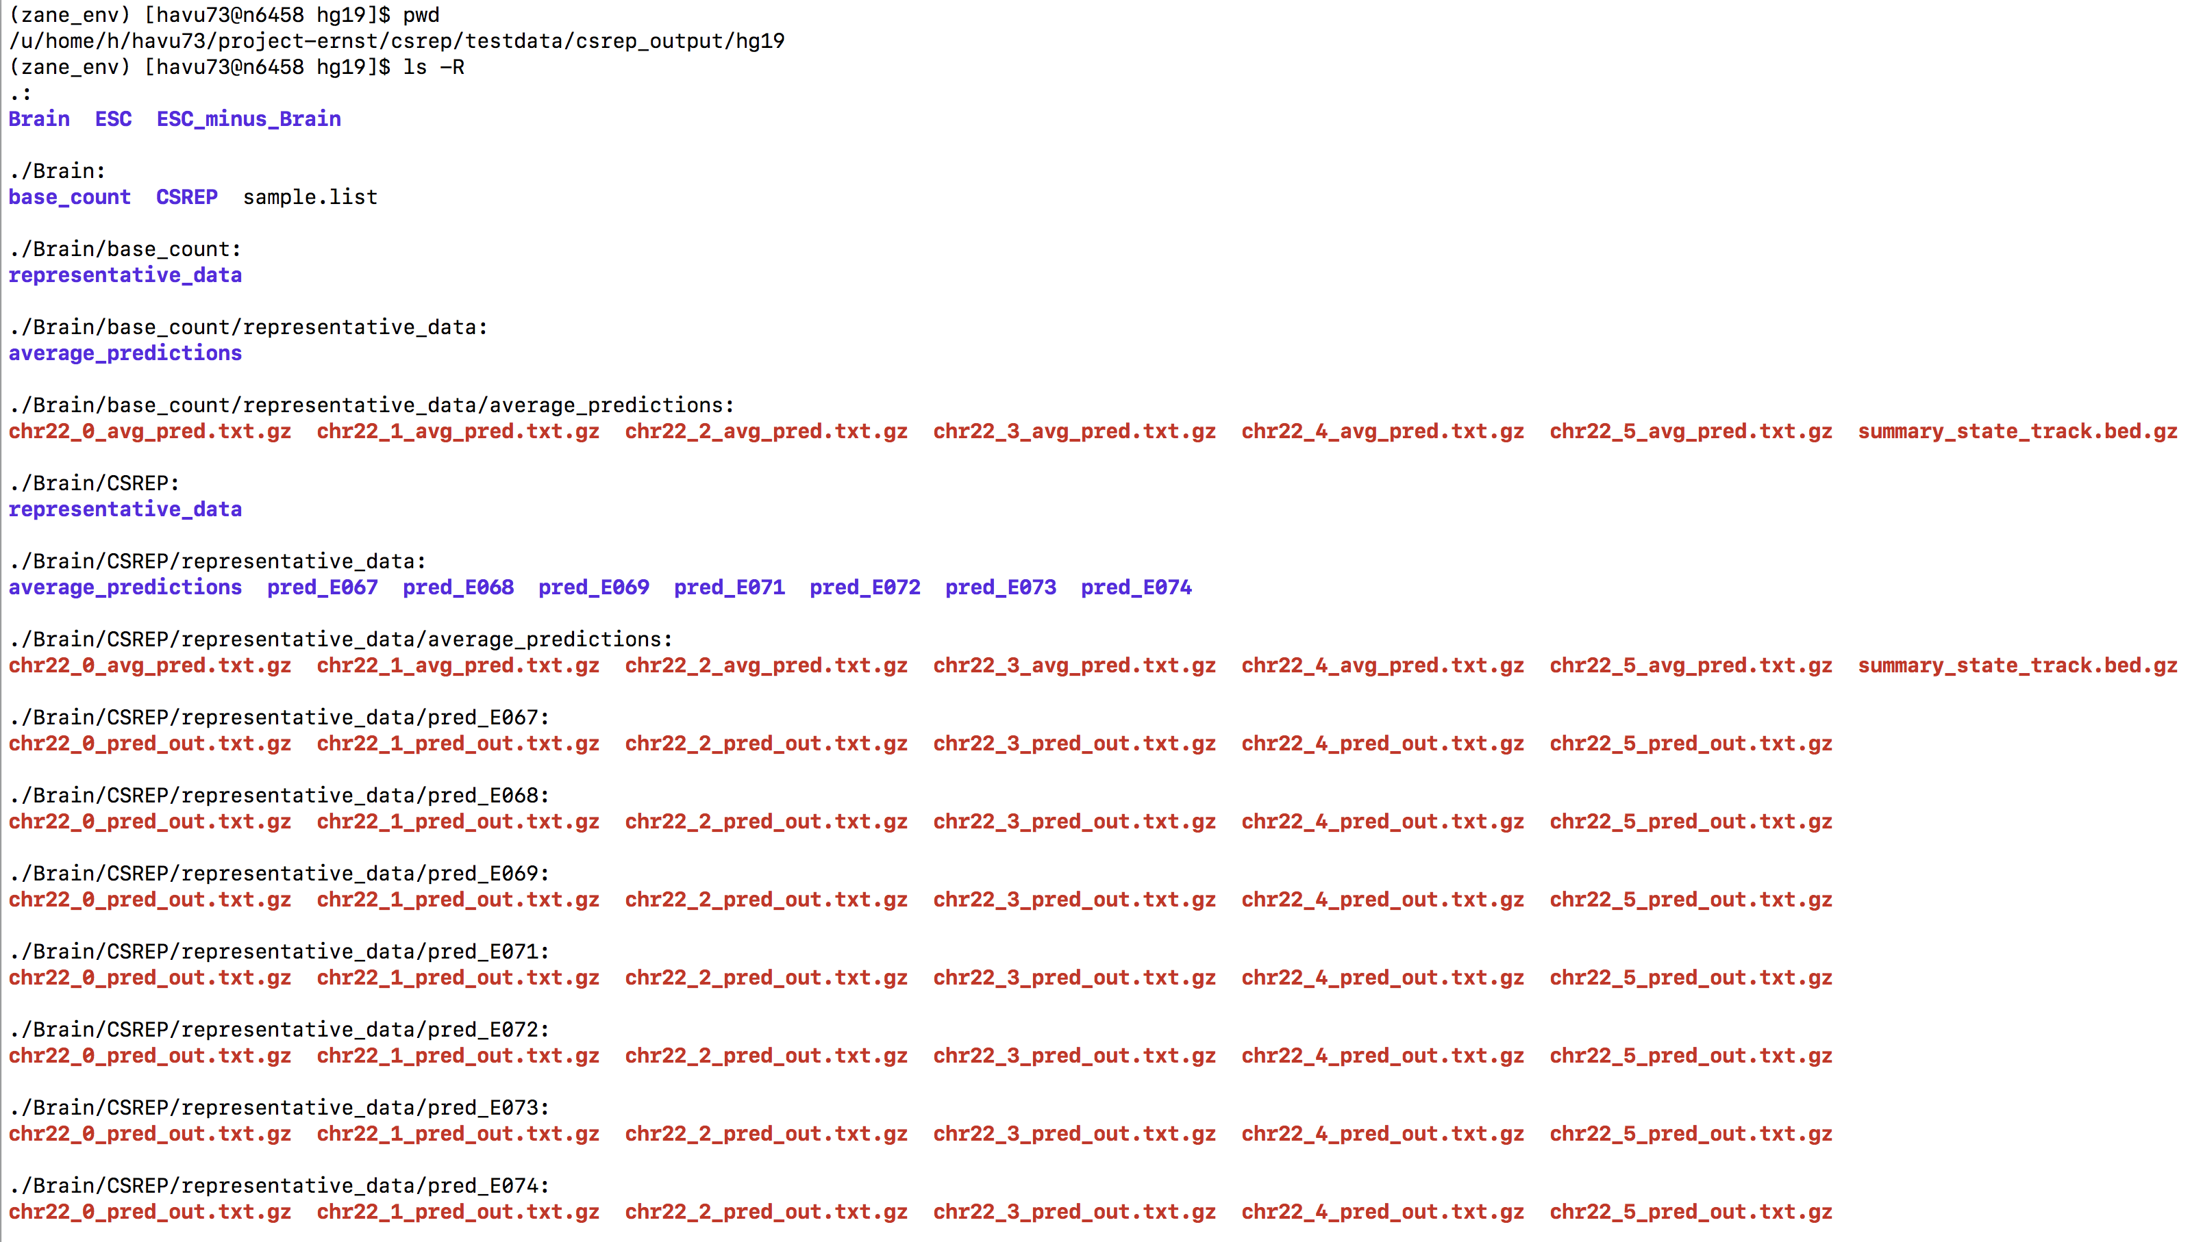
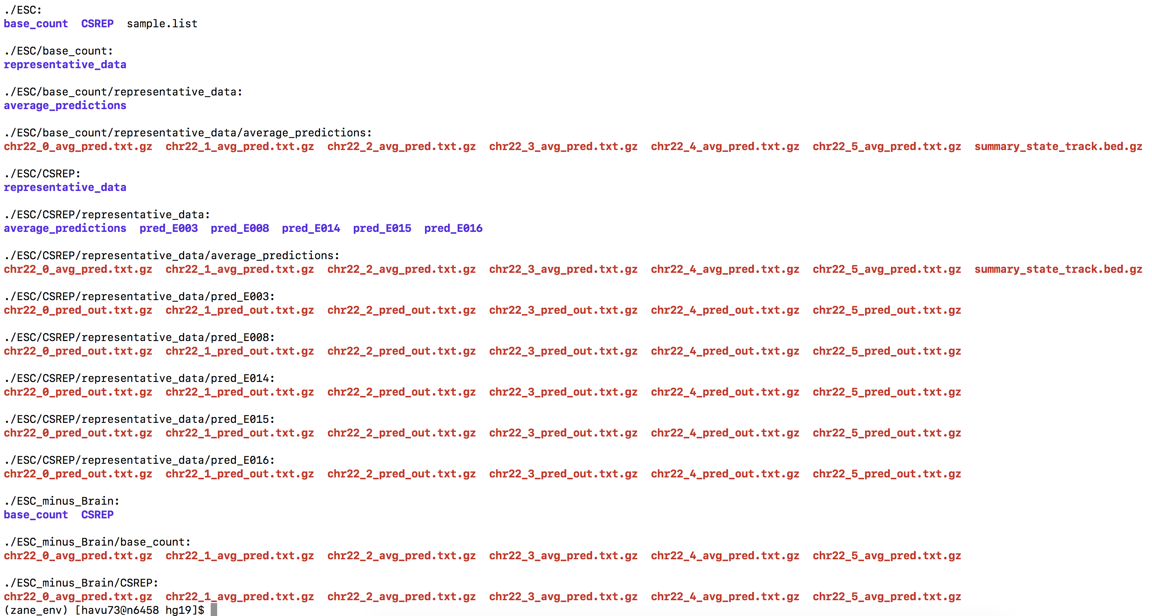
Output file structures
Page 1
Page 2
Folder csrep/testdata/csrep_output/hg19
Summary output data are in <group>/<method>/representative_data/average_predictions folder (example: csrep/testdata/csrep_output/hg19/ESC/CSREP/representative_data/average_predictions).
After CSREP finishes running and all files in folders <group>/<method>/representative_data/pred_<sampleID> (example: csrep/testdata/csrep_output/hg19/ESC/CSREP/representative_data/pred_E003) can be deleted by users.

Slide 14
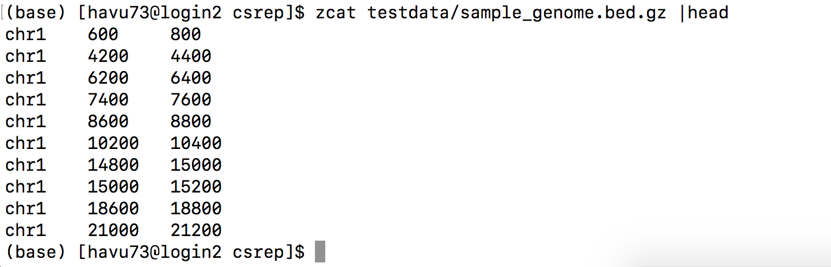
Some sample output
File testdata/sample_genome.bed.gz

Slide 15
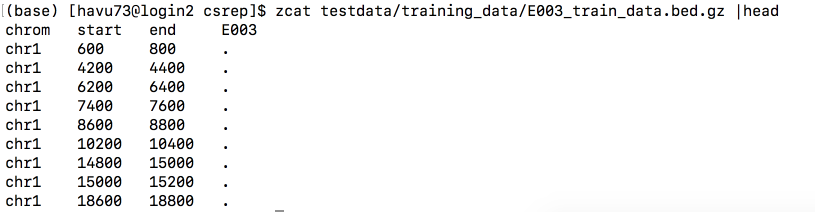
Some sample output
Folder containing training data:

Slide 16
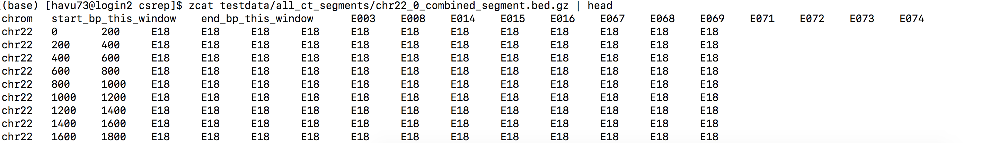
Some sample output
Folder testdata/all_ct_segments:

Slide 17
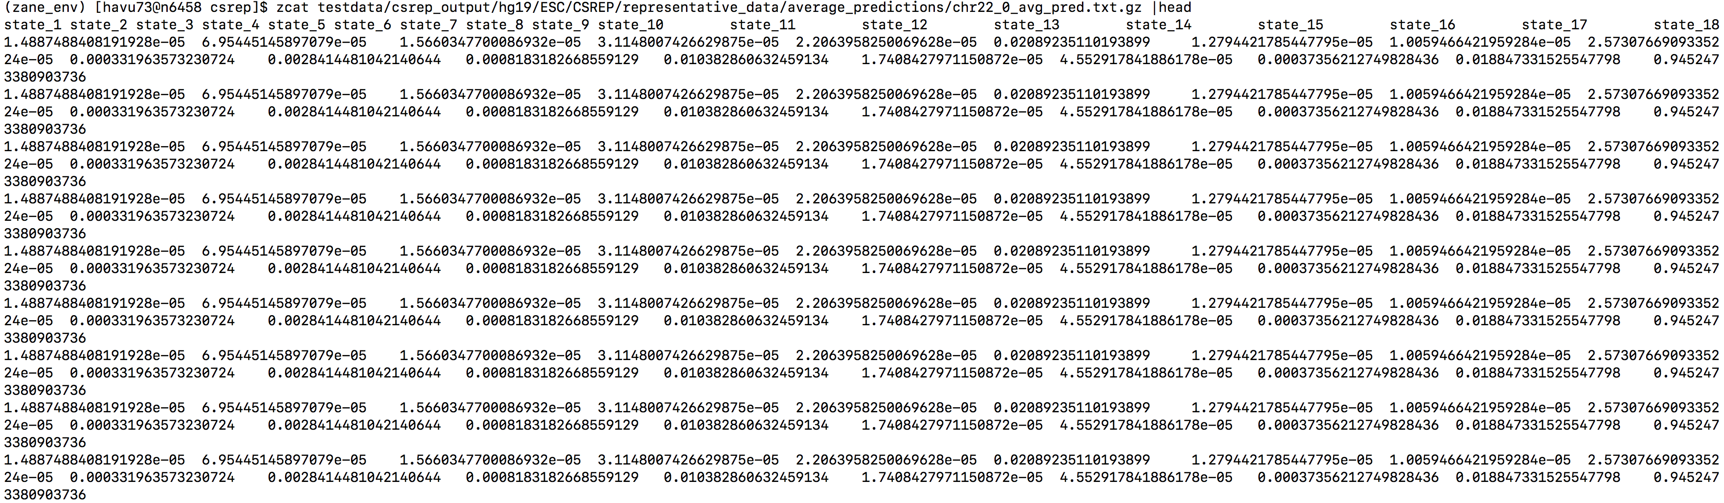
Some sample output
Folder testdata/csrep_output/hg19/ESC/CSREP/representative_data/average_predictions/
Sample output of summary chromatin state assignment matrix at region index chr22_0, for ESC, based on CSREP

Slide 18
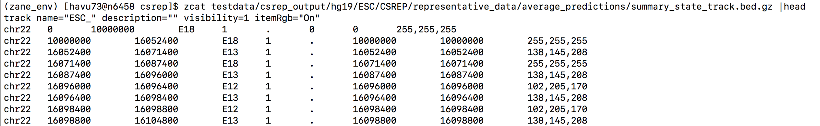
Some sample output
Folder testdata/csrep_output/hg19/ESC/CSREP/representative_data/average_predictions/
Sample output of summary chromatin state map for chr22, ESC, based on CSREP (can be read into UCSC genome browser)

Slide 19
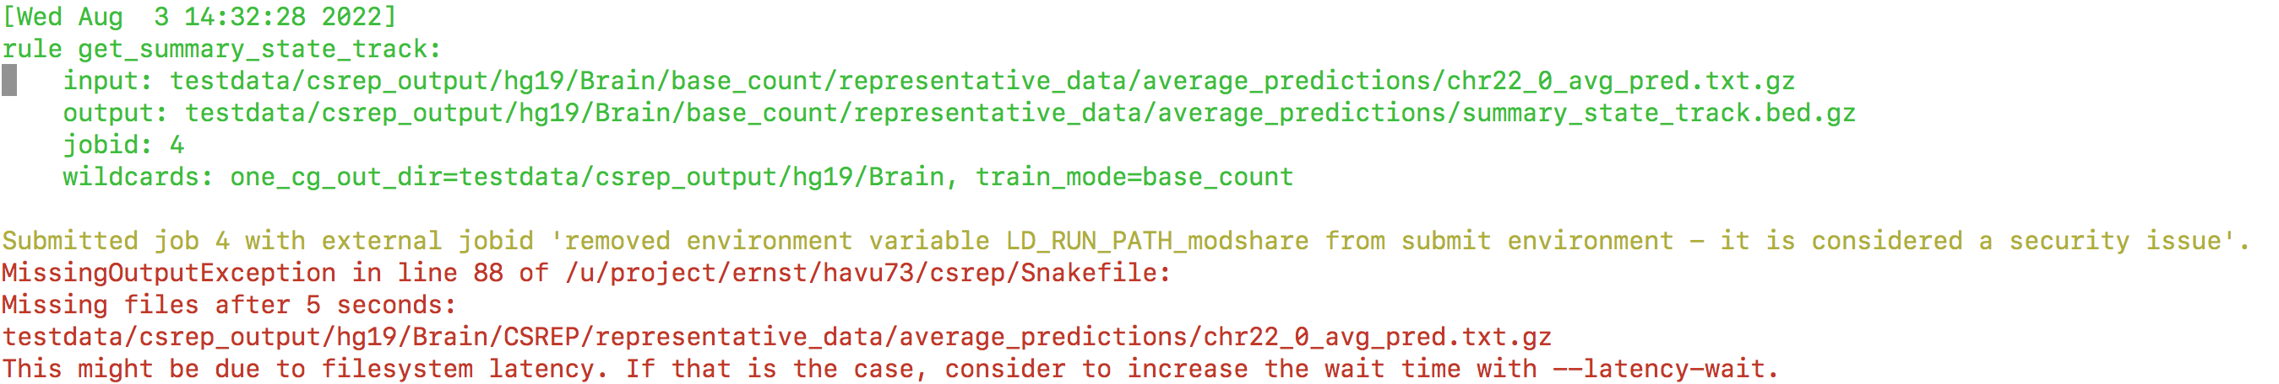
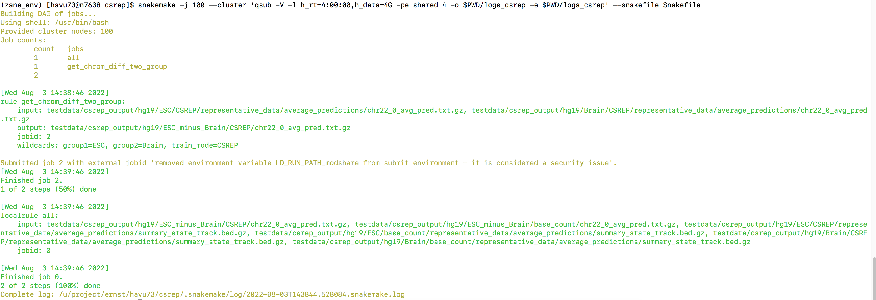
Some potential pitfalls: filesystem latency
Sometimes, snakemake may crash due to filesystem latency. It’s because one job finishes generating the output files, but snakemake may take a few seconds later to be able to update such status.
In this case, just let snakemake finishes crashing, and you can rerun snakemake. Snakemake will know to pick up where it left off and finish running unfinished jobs.

Slide 20
Contact
If you have any questions/ feedback, please contact:
Prof. Jason Ernst: jason.ernst@ucla.edu
Graduate student Ha Vu: havu73@ucla.edu

